Slide 1



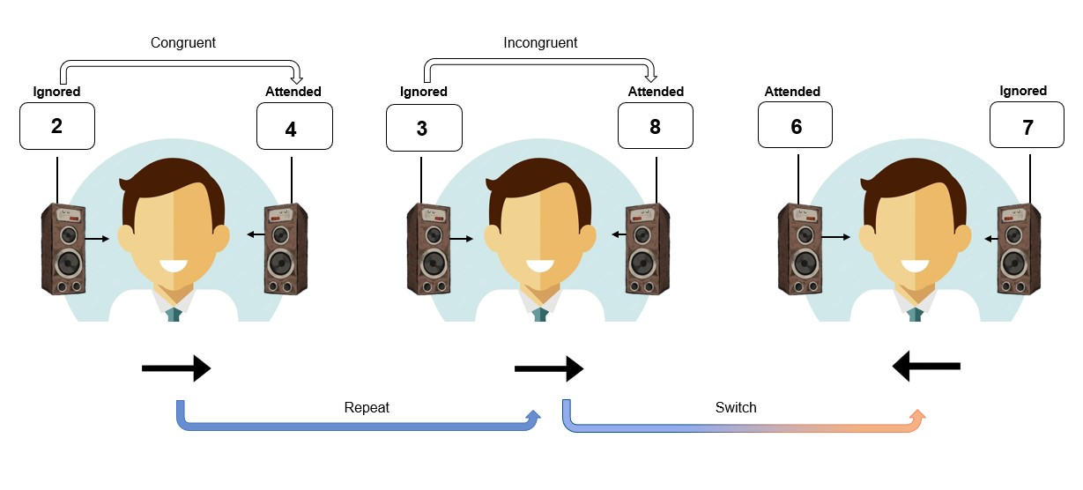
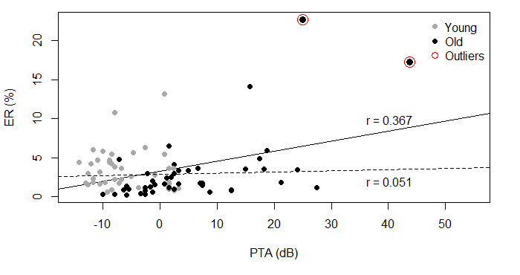
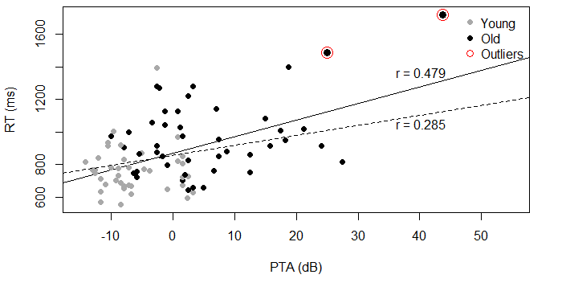
The mean audiograms for both participant groups are depicted
Age-Related Changes in Selective Listening:
Investigating Cognitive and Sensory Factors in Auditory Attention
#4034
Old
Luigi FALANGA¹, Thomas DEUTSCH², Janina FELS², Denise N. STEPHAN¹, and Iring KOCH¹
¹ Institute of Cognitive and Experimental Psychology | ² Institute for Hearing Technology and Acoustics | RWTH Aachen University, Germany
luigi.falanga@psych.rwth-aachen.de
Age-Related Changes in Selective Listening
The Present Study
Hearing Threshold: Pure Tone Audiometry (PTA)
Median Split Analysis
In complex auditory environments, multiple sound sources generate interfering acoustic information.
Auditory attention allows to selectively listen and prioritize the relevant sensory input while filtering out competing information.
This ability depends both on:
The quality of raw sensory inputs transmitted from the periphery
The efficiency of top-down attentional processes
During healthy aging, a mixture of sensory and attentional factors can negatively affect listening performance.
Our study investigates how sensory decline and cognitive aging contribute to age-related impairments in selective listening.
Trough a cued selective listening task (Koch et al., 2011) and Pure Tone Audiometry across two sessions, we assessed age-related differences during flexible auditory scene analysis, while accounting for interindividual differences in hearing sensitivity.
Participants’ hearing abilities was assessed using Pure Tone Audiometry (young adults mean: 8.93 dB; old adults mean: 19.54 dB).
PTA was a nonsignificant covariate in RT, F < 1, but was significant in ER analysis, F(1, 89) = 3.84, p = .05, η²p = .04.
To further explore the impact of sensory decline on listening performance, older participants were divided based on the group’s median hearing threshold (good vs. poor hearing)
Congruent
Incongruent
Good hearing
Poor hearing
Repeat
Switch
Composite audiograms (young vs. old) indicating non-pathological ARHL (World Health Organization, 1991). Older adults showed a moderate sensory decline in higher frequencies.
Older individuals with poor hearing abilities were more error prone (3.1%), relative to those with good hearing abilities (1.6%), F(1, 43) = 5.21, p = .028, η²p = .108.
Sensory Decline
Congruency (congruent vs. incongruent)
Auditory attention switch (repeat vs. switch)
Session (1 vs. 2)
Age group (young vs. old)
Old
Age-related hearing loss (ARHL) is a gradual decrease of hearing sensory abilities observed while aging. It impairs the detection of sound frequencies, thereby affecting the processing of sensory inputs (Katz et al., 2015)
Even mild levels of ARHL can impair the ability to extract meaning information from complex auditory environments (Russell, 2022).
Hearing thresholds (PTA) were averaged across three frequencies: 500 Hz, 1000 Hz, and 2000 Hz (WHO, 1991), providing a continuous measure indicating participant's sensory hearing ability.
Results
In Error Rate (ER), older adults showed larger switch cost (1.4%) relative to younger adults (0.3%), F(1, 88) = 39.14, p < .001, η²p = .31.
Poor hearing
Good hearing
No differences were observed between older individuals with good and poor hearing abilities.
Cognitive Aging
Discussion
The ability to inhibit irrelevant information is the primary cognitive function that declines with age (see Rey-Mermet & Gade, 2018, for a review).
Under flexible task requirements, older adults often show increased performance costs (e.g., switch cost), suggesting reduced cognitive flexibility (Hirsch et al., 2016; Schils et al., 2024)
Theories of cognitive control in task switching suggest that inhibitory processes may be critical in determining switch costs, by reducing the interference of the previously relevant task or attention set (Koch et al., 2010).
The greater switch cost observed in older relative to younger adults, indicates that older adults experience greater difficulty in reconfiguring their attention set under flexible task demands (Hirsch et al., 2016). This performance cost, and the increased congruency effect during switch trials, suggest that listening impairment in the older population is not driven entirely by sensory decline.
While poorer sensory hearing abilities are associated with general processing speed, and partially explains accuracy in the older group, our results indicate that non-pathological sensory decline, does not influence switch cost or congruency effect.
Therefore, cognitive aging, and inhibitory deficit play a critical role in determining age-related impairment during flexible auditory scene analysis (Rey-Mermet & Gade, 2018).
Greater congruency effect during switch relative to repeat trials in the older (3.9% vs. 2.2%), but not in the younger group (2.4% vs. 2.0%), F(1,88) = 10.10, p = 0.02, η²p < .01.
The scatter plot highlight one older individual with a moderate level of ARHL, and one outlier. After removing these older participants correlation shows a non significant relationship between individual hearing thresholds and ERs, r = .05, t(90) = 0.48, p = .063.
Binding:
task 1 + red ink
Practice Benefit
In Reaction Time (RT), older adults showed general slowing, F(1,88) = 21.67, p < .001, η²p = .20, and larger switch cost (79 ms) relative to young adults (49 ms), F(1, 88) = 15.92, p < .001, η²p = .15
+
150 ms
150 ms
FILL
ANY TARGET
Practice can improve participants cognitive performance
(Toovey et. al., 2021)
Aging is associated with reduced cognitive plasticity.
Toovey et al., (2021) demonstrated that older adults can benefit from repeated exposure to environmental demands, but their ability to adjust to more flexible task demands, remains constrained.
KIND
KIND
300 ms
SHAPE
ANY TARGET
References
KIND
max 2500 ms
FILL
KIND
ANY TARGET
Hirsch, P., Schwarzkopp, T., Declerck, M., Reese, S., & Koch, I. (2016). Age-related differences in task switching and task preparation: Exploring the role of task-set competition. Acta Psychologica 170, 66–73.
Katz, J., Chasin, M., English, K., Hood, L. J., & Tillery, K. L. (2015). Handbook of clinical audiology ( 7th ed.). Wolters Kluwer Health.
Koch, I., Gade, M., Schuch, S., & Philipp, A. M. (2010). The role of inhibition in task switching: A review. Psychonomic Bulletin & Review, 17(1), 1–14.
Koch, I., Lawo, V., Fels, J., & Vorländer, M. (2011). Switching in the cocktail party: Exploring intentional control of auditory selective attention. Journal of Experimental Psychology: Human Perception and Performance, 37(4), 1140–1147.
Rey-Mermet, A., & Gade, M. (2018). Inhibition in aging: What is preserved? What declines? A meta- analysis. Psychonomic Bulletin & Review, 25(5), 1695–1716.
Russell, M. K. (2022). Age and auditory spatial perception in humans: Review of behavioral findings and suggestions for future research. Frontiers in Psychology, 13, 831670.
Schils, L. A. P., Koch, I., Huang, P.-C., Hsieh, S., & Stephan, D. N. (2024). Impact of aging on crossmodal attention switching. Psychological Research, 88(7), 2149–2159.
Toovey, B. R. W., Kattner, F., & Schubert, T. (2021). Cross-modal transfer following auditory task- switching training in old adults. Frontiers in Psychology, 12, 615518.
World Health Organization. (1991). Report of the informal working group on prevention of deafness and hearing impairment programme planning, Geneva, 18–21 June 1991.
TREE
Aim of the Present Study
What explains age-related differences in listening performance?
Sensory decline
Cognitive aging
Do auditory switch cost and congruency effect differ between age groups?
Greater reduction of switch costs across sessions for younger individuals compared to older ones (31 ms vs. 12 ms, respectively),
F(1, 88) = 3.77, p = .056, η²p = .04. This three-way interaction was significant only when using log-transformed reaction time as the dependent variable, F(1, 88) = 4.98, p = .027, η²p = .05.
The correlation between individual hearing thresholds and RTs was significant, r = .26, t(90) = 2.82, p = .006. The general slowing observed in older individuals is influenced by their hearing sensory abilities.
65th Annual Meeting of the Psychonomic Society | New York | Nov 21th-24th 2024

